Slide 1

Finding MIMO
Final Meeting: Week 9
Kate Bowers, Kristopher Jung, Samuel Spillane

Slide 2
Project Goals
Model receiver-side CEs to determine the best way to decode received signals
Choose equalization algorithm and parameters √
Choose channel estimation technique √
Optimize parameters for the best Bit Error Rate (BER), Power Gain, or throughput √
Create a working MIMO implementation with equalization √
Create a high-quality research paper that conveys the novelty of our project

Slide 3

Progress and challenges
Initial draft of paper (minus results and background) completed
Investigation of DFE implementations
Worked on implementation, still dysfunctional
Decided to cut parameter changing
Parameterization of all equalizers for integration
Finalized equalizers: MMSE, ZF, ML Detection
Added OFDM to baseline model
Need indepth verification

Slide 4
Research Paper
Majority of paper is finished and edited!
Introduction √
Literature Review √
System Model √
Methodology √
Background
Results
Conclusions

Slide 5

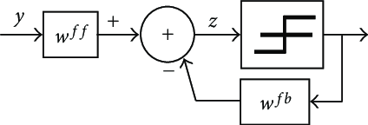
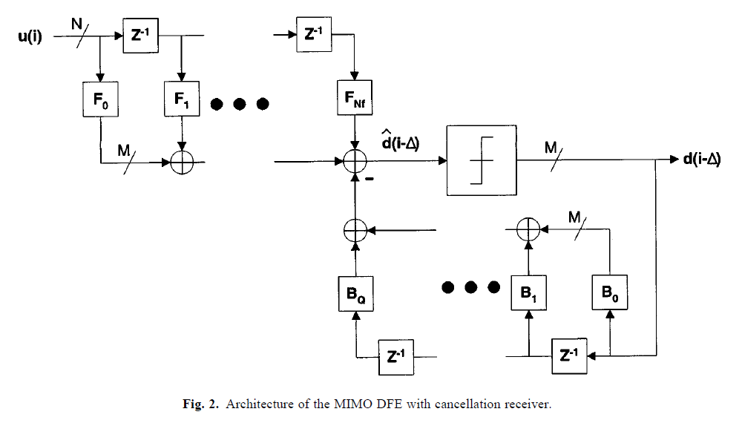
Progress and challenges Contd.
SISO DFE
MIMO DFE
MATLAB implementation

Slide 6
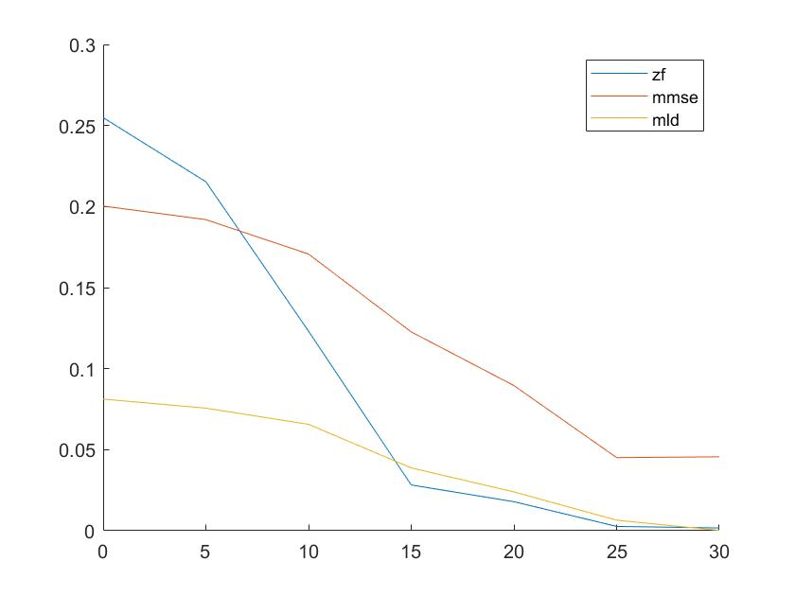
ZF/MMSE/MLD
4 x 2 MIMO OFDM Watterson
BPSK
Only 1 simulation iteration for this demonstration
128 FFT length
16 cyclic prefix.
144 syms per frame.
100 frames
0:5:30 SNR for this demonstration

Slide 7
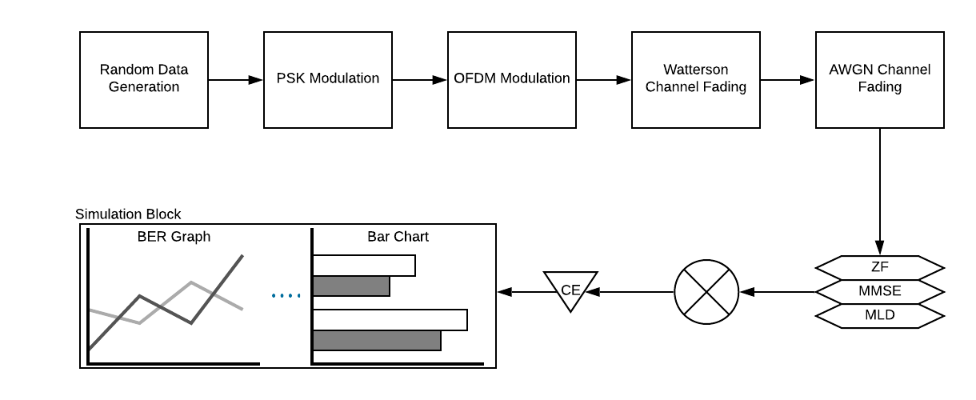
End-game research design.

Slide 8
Roadmap
Week 9
Create graphics for paper
Finish writing paper
Continue attempts at DFE if time permits
Continue attempts at SIC equalizers if time permits
Videos

Slide 9
Questions?

